Slide 1
Ukkonen's algorithm
Rohit Kumar sahu(181IT138)- 6264538643
channamallikarjuna(181IT212)-8296517155
Hritwik arya(181IT218)-8340135471
Shivaprasad Nayak(181IT149)-9741098265

Slide 2
INTRODUCTION
Ukkonen's algorithm is a linear-time, online algorithm for constructing suffix trees.
ONLINE ALGORITHM- an online algorithm is one that can process its input piece-by-piece in a serial fashion, i.e., in the order that the input is fed to the algorithm, without having the entire input available from the start.
The algorithm begins with an implicit suffix tree containing the first character of the string. Then it steps through the string, adding successive characters until the tree is complete. This order addition of characters gives Ukkonen's algorithm its "on-line" property.

Slide 3
contd..
Ukkonen's algorithm is a method of constructing the suffix tree of a string in linear time. Suffix trees are useful because they can efficiently answer many questions about a string, such as how many times a given substring occurs within the string.
The algorithm works in steps, from left to right. There is one step for every character of the string. Total number of operations is O(n).

Slide 4
Suffix tree
A suffix tree T for a m-character string S is a rooted directed tree with exactly m leaves numbered 1 to m. (Given that last string character is unique in string)
Root can have zero, one or more children.
Each internal node, other than the root, has at least two children.
Each edge is labelled with a nonempty substring of S.
No two edges coming out of same node can have edge-labels beginning with the same character.

Slide 5
Implicit Suffix Trees
Ukkonen’s alg constructs a sequence of implicit STs, the last of which is converted to a true ST of the given string.
An implicit suffix tree for string S is a tree obtained from the suffix tree for S$ by
removing $ from all edge labels
removing any edge that now has no label
removing any node with only one child

Slide 6
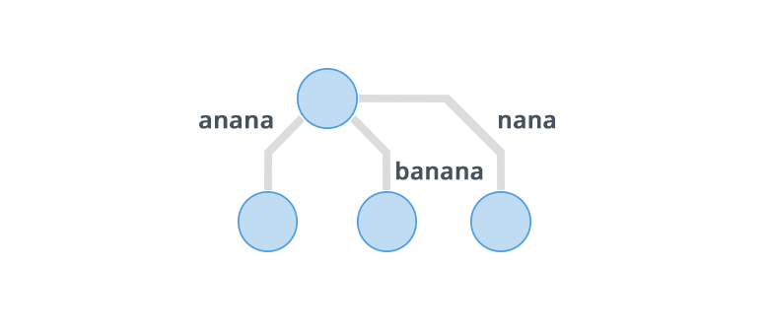
Example
Implicit Suffix Tree
for the string “banana”

Slide 7
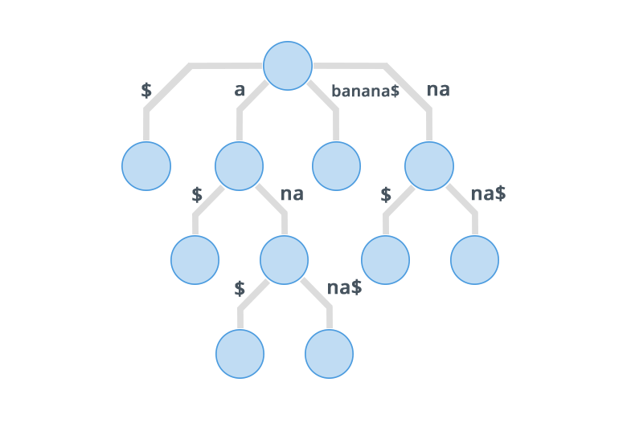
Contd...
To avoid getting an Implicit Suffix Tree we append a special character that is not equal to any other character of the string. We append $ to the given string then, so the new string is "banana$"
. Now its suffix tree will be

Slide 8
Why Suffix Trees?
● Asymptotically fast.
● The basis of state of the art data structures.
● You don't need a Phd to use them.
● Challenging.
● Expose interesting algorithmic ideas

Slide 9
Extension rules:
Rule 1: If the path from the root labelled S[j..i] ends at leaf edge (i.e. S[i] is last character on leaf edge) then character S[i+1] is just added to the end of the label on that leaf edge.
Rule 2: If the path from the root labelled S[j..i] ends at non-leaf edge (i.e. there are more characters after S[i] on path) and next character is not s[i+1], then a new leaf edge with label s{i+1] and number j is created starting from character S[i+1].
A new internal node will also be created if s[1..i] ends inside (in-between) a non-leaf edge.
Rule 3: If the path from the root labelled S[j..i] ends at non-leaf edge (i.e. there are more characters after S[i] on path) and next character is s[i+1] (already in tree), do nothing.

Slide 10
Applications
Suffix trees can be used to solve a large number of string problems that occur in text-editing, free-text search, computational biology and other application areas. Primary applications are:
String search, in O(m) complexity, where m is the length of the sub-string (but with initial O(n) time required to build the suffix tree for the string)
Finding the longest repeated substring
Finding the longest common substring
Finding the longest palindrome in a string

Slide 11
Suffix Tree Applications
Suffix Trees can be used to solve a large number of string problems that occur in text-editing, free-text search, computational biology, and other application areas. Some examples are given below.
String Search
Searching for a substring, pat[1..m], in txt[1..n], can be solved in O(m) time (after the suffix tree for txt has been built in O(n) time).
Longest Repeated Substring
Add a special ``end of string'' character, e.g. `$', to txt[1..n] and build a suffix tree; the longest repeated substring of txt[1..n] is indicated by the deepest fork node in the suffix tree, where depth is measured by the number of characters traversed from the root, i.e., `issi' in the case of `mississippi'. The longest repeated substring can be found in O(n) time using a suffix tree.

Slide 12
Contd...
Longest Common Substring
The longest common substring of two strings, txt1 and txt2, can be found by building a generalized suffix tree for txt1 and txt2: Each node is marked to indicate if it represents a suffix of txt1 or txt2 or both. The deepest node marked for both txt1 and txt2 represents the longest common substring.
Palindromes
A palindrome is a string, P, such that P=reverse(P). e.g. `abba'=reverse(`abba'). e.g. `ississi' is the longest palindrome in `mississippi'.
The longest palindrome of txt[1..n] can be found in O(n) time, e.g. by building the suffix tree for txt$reverse(txt)# or by building the generalized suffix tree for txt and reverse(txt).

Slide 13
A naive algorithm to build a suffix tree
Given a string S of length m, enter a single edge for suffix S[l ..m]$ (the entire string) into the tree, then successively enter suffix S[i..m]$ into the growing tree, for i increasing from 2 to m. Let Ni denote the intermediate tree that encodes all the suffixes from 1 to i.
So Ni+1 is constructed from Ni as follows:
Start at the root of Ni
Find the longest path from the root which matches a prefix of S[i+1..m]$
Match ends either at the node (say w) or in the middle of an edge [say (u, v)].
If it is in the middle of an edge (u, v), break the edge (u, v) into two edges by inserting a new node w just after the last character on the edge that matched a character in S[i+l..m] and just before the first character on the edge that mismatched. The new edge (u, w) is labelled with the part of the (u, v) label that matched with S[i+1..m], and the new edge (w, v) is labelled with the remaining part of the (u, v) label.
Create a new edge (w, i+1) from w to a new leaf labelled i+1 and it labels the new edge with the unmatched part of suffix S[i+1..m]

Slide 14
Ukkonen's algorithm
Construct tree T1
For i from 1 to m-1 do
begin {phase i+1}
For j from 1 to i+1
begin {extension j}
Find the end of the path from the root labelled S[j..i] in the current tree.
Extend that path by adding character S[i+l] if it is not there already
end;
end;
Suffix extension is all about adding the next character into the suffix tree built so far.
In extension j of phase i+1, algorithm finds the end of S[j..i] (which is already in the tree due to previous phase i) and then it extends S[j..i] to be sure the suffix S[j..i+1] is in the tree.

Slide 15
Here we have implemented two applications
1.Document similarity
2.Tweet similarity

Slide 16
Text pre-processing
converting all letters to lower or upper case
converting numbers into words or removing numbers
removing punctuations, accent marks and other diacritics
removing white spaces
removing stop words

Slide 17
Suffix tree Construction
After preprocessing, the next step is to create a structure which represents all common substrings between tweets. For this purpose, we used a generalized suffix tree. Each node in the suffix tree represents a word of a tweet or multiple tweets and each leaf contains the ids of tweets which contain the string the leaf represents. The set of tweet ids of each node can be found by aggregating the tweet ids from descendant leaves.

Slide 18
Generalised suffix tree
A generalized suffix tree is a variation on a suffix tree in which the suffixes for two (or more) distinct strings T1 and T2 are stored, not just the suffixes of one string T.
One way to build a generalized suffix tree is to start by making a suffix tree for T1$1T2$2. This resulting suffix tree will contain all the suffixes of T1 and T2, but it will also contain a lot of "spurious" suffixes that start in T1 and spread into T2. To fix this, after building the initial suffix tree, you would typically make a second pass over the tree structure and eliminate any suffixes that extend past the $1 marker. This is why, for example, the generalized suffix tree you gave above doesn't contain ABAB$1BABA$2.

Slide 19
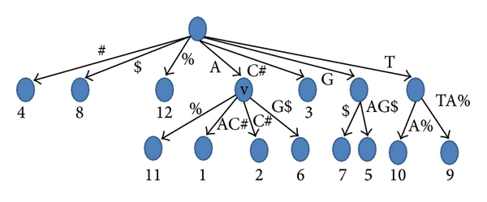
Generalised suffix tree Example
A generalized suffix tree for the string AAC#GAG$TTA%. The numbers below the leaves are the text positions for the string paths which are represented by these leaves.

Slide 20
THANK YOU

